Slide 2
冒險故事
緊急
WARNING

Slide 3
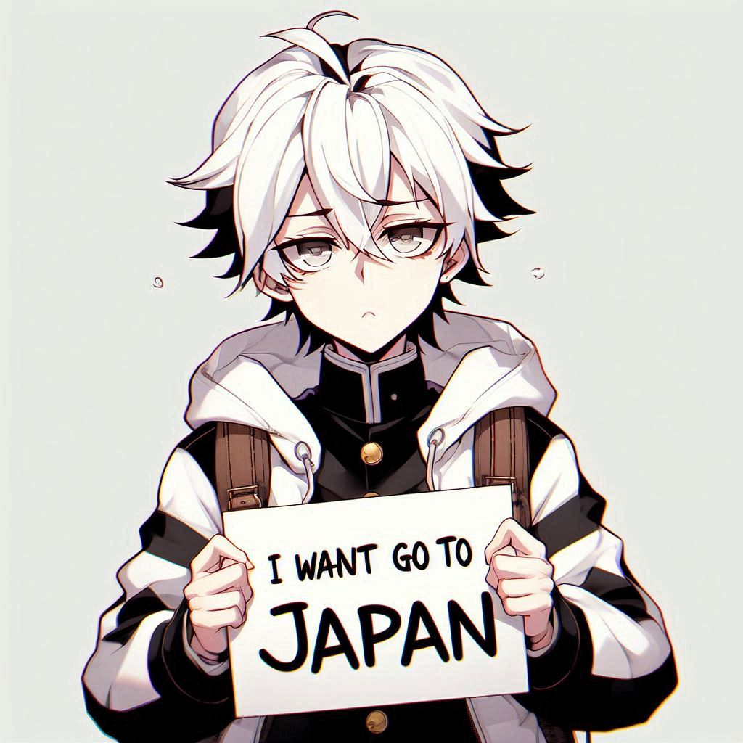
1.目標
ATTENTION
Notes:
Make me a picture in anime style of a man with white hair wearing a black and white jacket who wants to go to japan

Slide 4
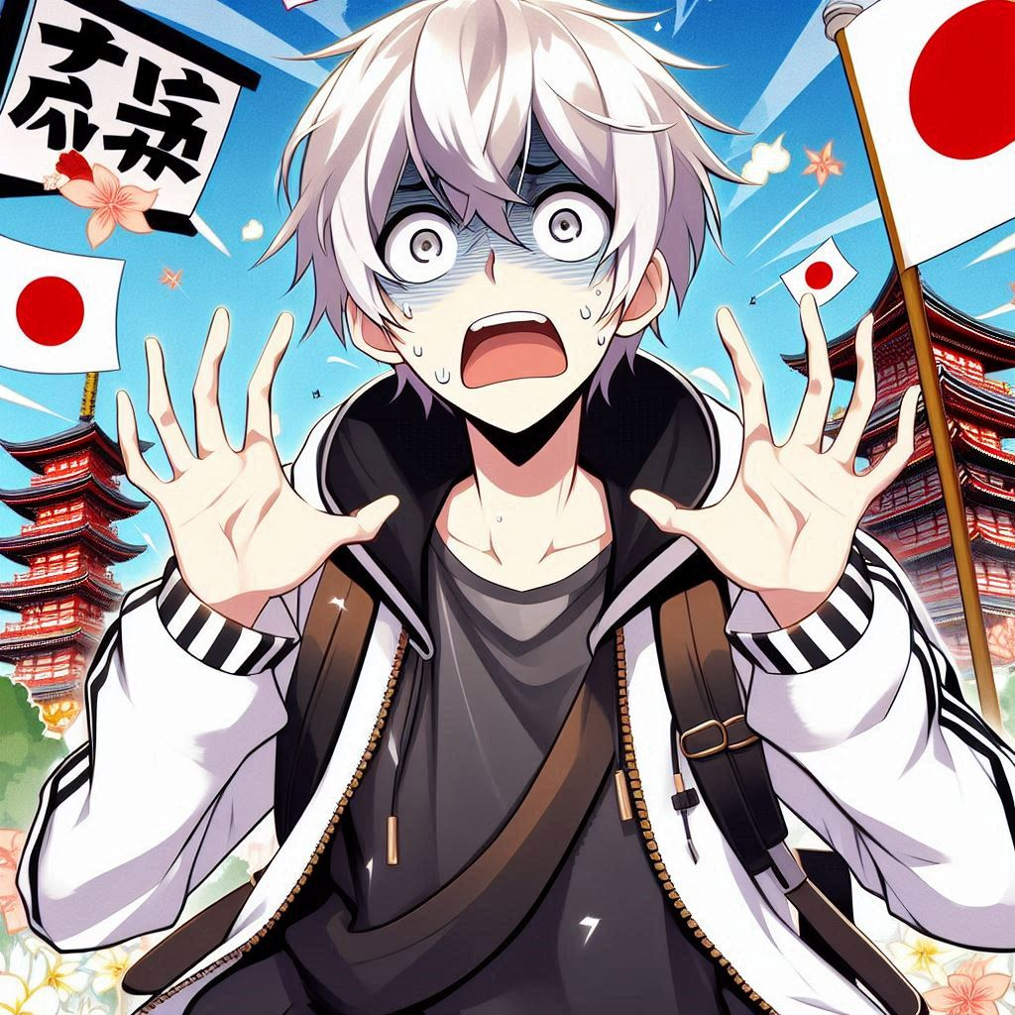
2.阻礙
ATTENTION
Notes:
Make me a picture in anime style of a man with white hair wearing a black and white jacket is panic because he never went to japan before

Slide 5
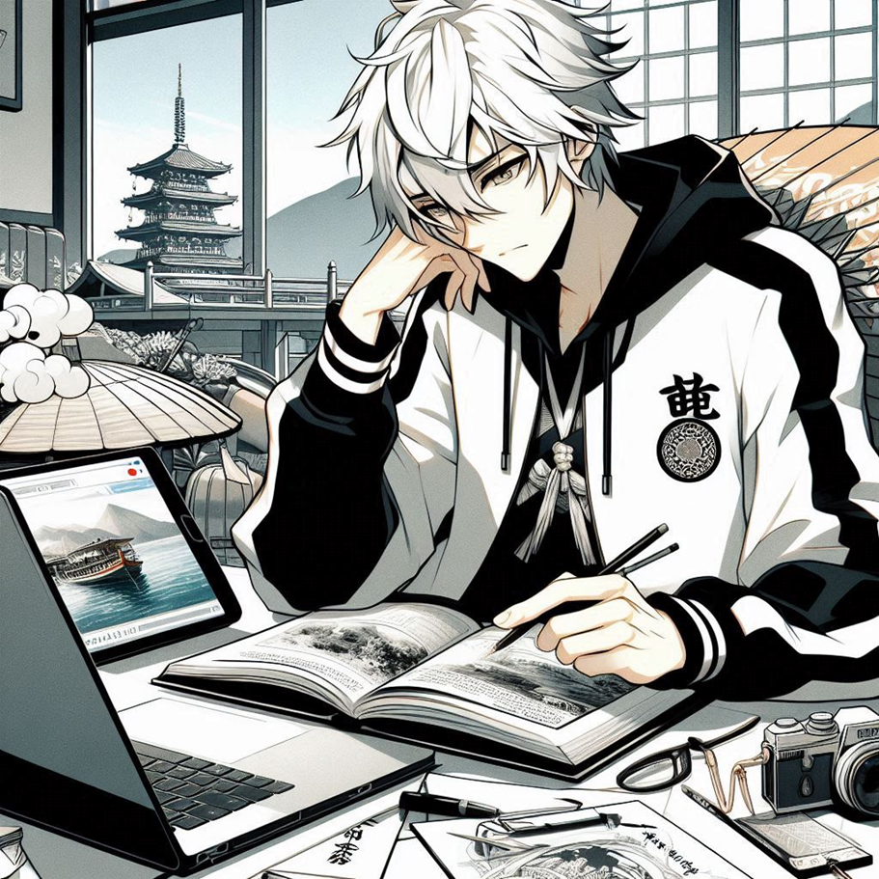
3.努力
ATTENTION
Notes:
Make me a picture in anime style of a man with white hair wearing a black and white jacket who study a lot how to organize a vacation to japan

Slide 6
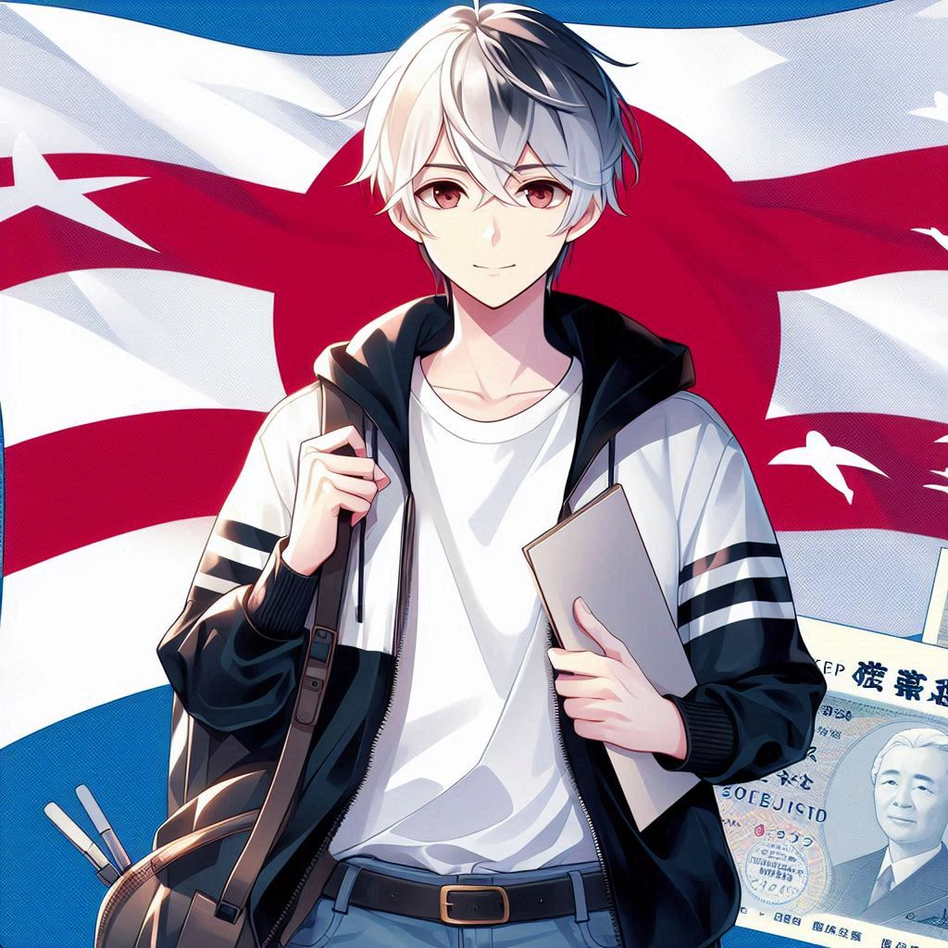
4.結果
ATTENTION
Notes:
Make me a picture in anime style of a man with white hair wearing a black and white jacket succesfully went to japan

Slide 7
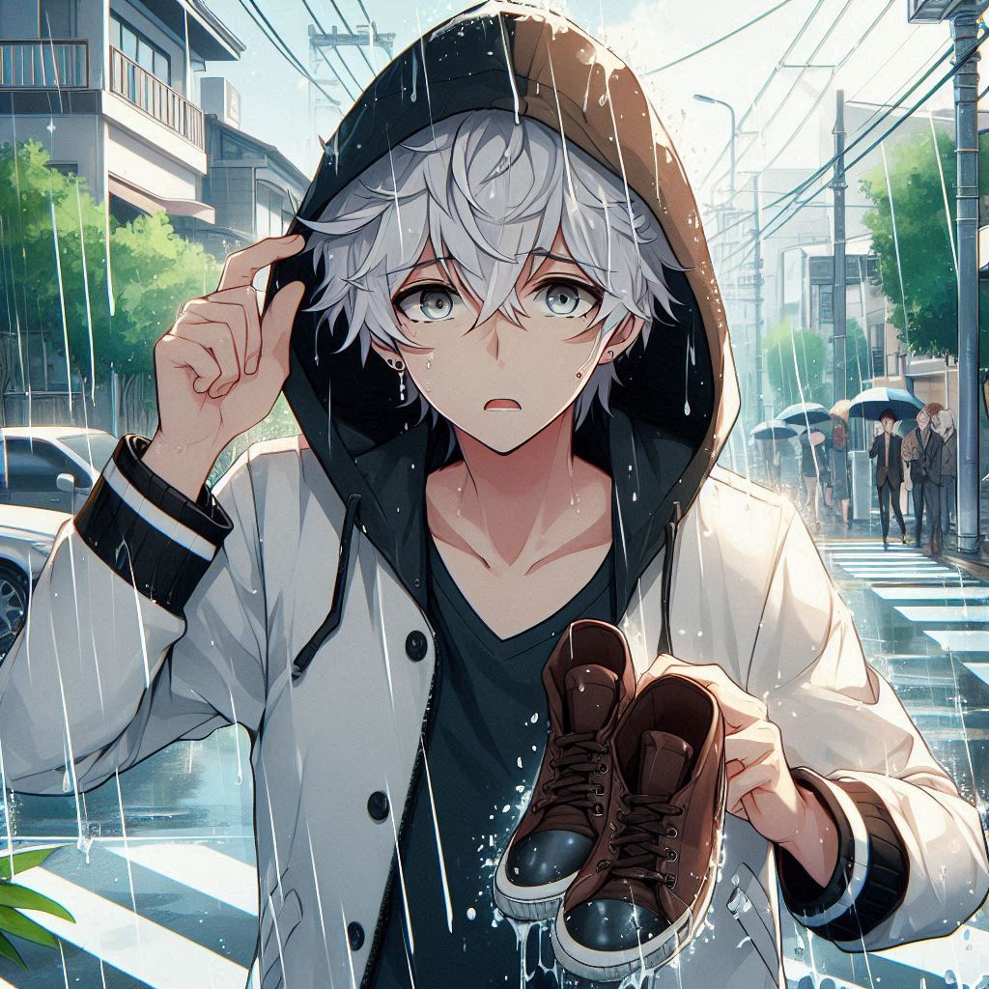
5.意外
ATTENTION
Notes:
Make me a picture in anime style of a man with white hair wearing a black and white jacket encountered heavy rain on his forth day of his vacation to japan and also his shoes is broken

Slide 8
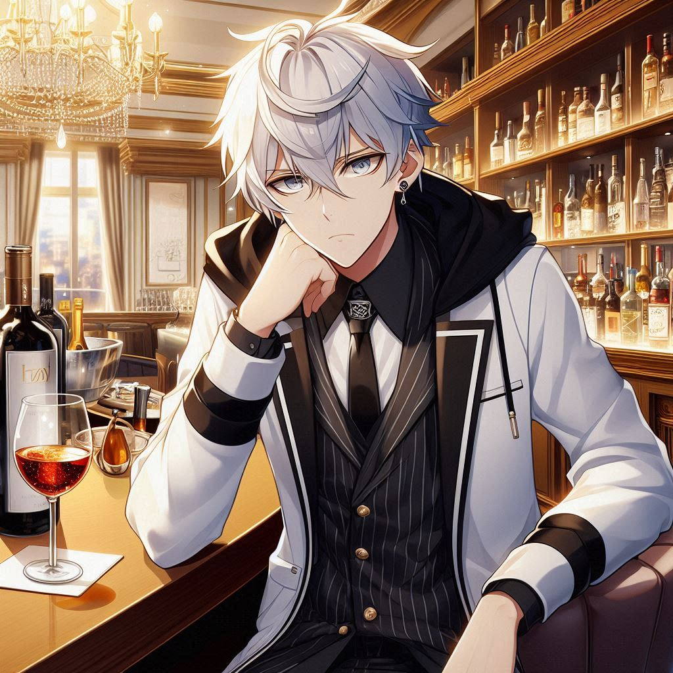
6.轉彎
ATTENTION
Notes:
Make me a picture in anime style of a man with white hair wearing a black and white jacket drinking at a bar in the hotel

Slide 9
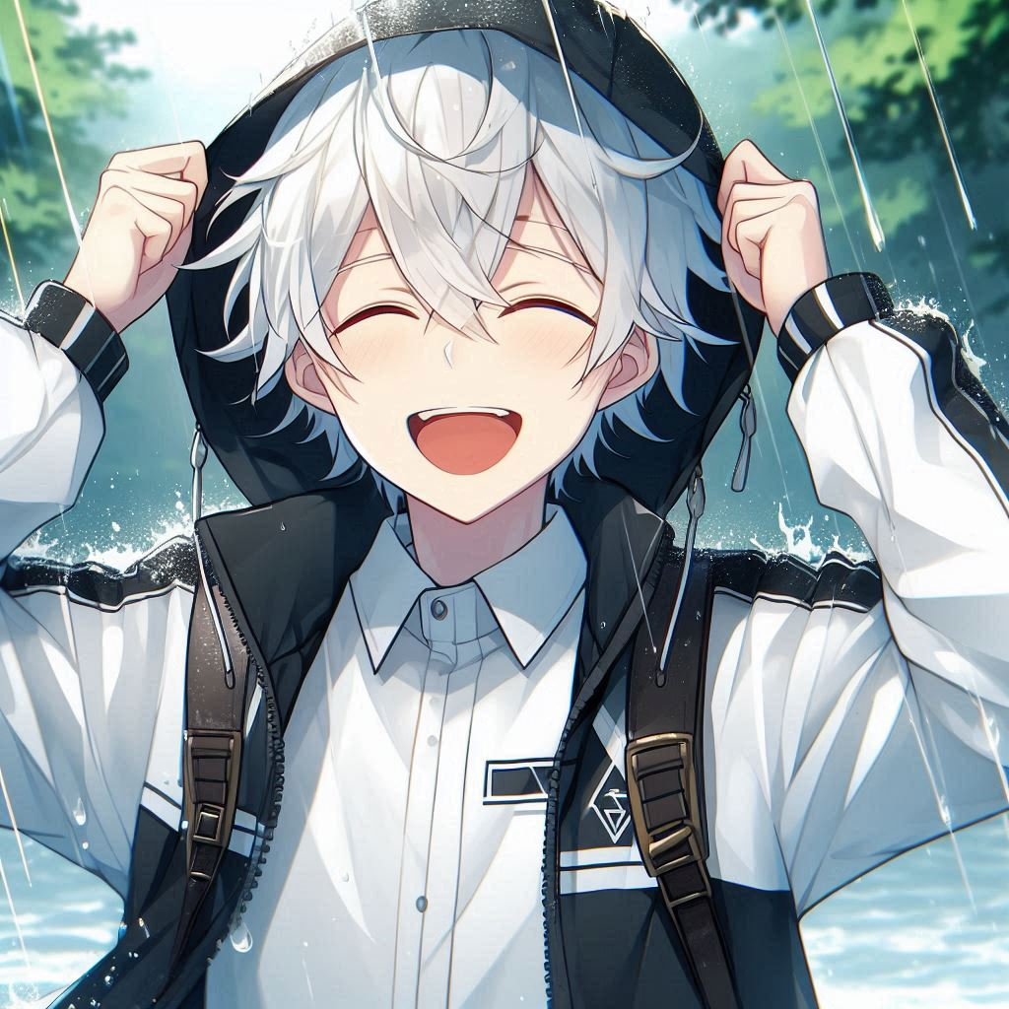
7.結局
ATTENTION
Notes:
Make me a picture in anime style of a man with white hair wearing a black and white jacket is happy because the rain stops and he can continue his vacation

Slide 10
非常事態
THE END

